Slide 1
Data Management Planning for grant writing: Biomedicine & Health Science
Library Research Support

Slide 2
What is research data?
Information either created or used as an integral part of research.
Can be born digital or digitised
Data underpins research claims.
May have high re-use value for other researchers.
Notes:
Research data is simply the evidence you have collected or created to underpin your research, and to validate your research claims. You might have created it, scanned it, measured it, photographed, or recorded it, or read and compiled it.
It doesn't include consent forms, websites, project reports, or the administrative data generated during running the project.
It may have value to other researchers because it would be time consuming, costly or impossible to recreate. Even researchers in other disciplines may find the data useful.

Slide 3
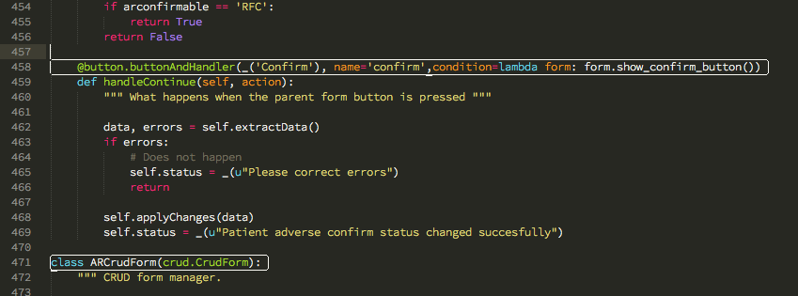
Scan of a lab book
An interview transcript
Database of measurements
Digital photographs or video
New software or code
Online survey results
Notes:
These are some of the types of data you may generate in Science and Engineering. It ranges from scans of lab books or electronic lab books, photographs, x-rays, MRI, or tomography scans, calculations, code, databases of measurements, to audio recording and online interviews, including recorded video.

Slide 4
Research data & grant writing
90% of top funders now mandate research data management
Most ask for a Data Management Plan (DMP) at application which covers: data creation, organisation, documentation, storage, preservation & sharing plans
Medical Research Council Standard Application; Wellcome Trust Fellowship
Check your funder’s data policy before applying
Notes:
The vast majority of funders (and all the big ones) now require a Data Management Plan, usually at the application stage. The plan covers the following:
What data you will create:
'bundles' of data types, eg. 200x interviews in word documents, 3 x calculation in spreadsheets, 1x instrumentation outputs collated in databases, 1000 x X-rays of patients, so the funder knows you have thought out all of the separate strands of data which will be generated
file types – eg. .docx, .pdf, .xlsx, .jpeg, .tiff and any specific proprietary software file types, so you can roughly estimate the size of each 'bundle' - some data may be generated in one file format for working, but converted to an open and/or less data intensive format for preservation and sharing
Estimated size of the data generated during the project, so the funder knows this has been budgeted for – UoB has a 5TB allowance per PI, split across however many projects they have (see later slide).
How you will organise it:
How you will set up file naming conventions and routines for saving data
Who will be responsible for day to day management of the data
Quality control processes
What documentation you will need to understand and replicate or reproduce it:
Additional documentation, protocols, readme.txt files,
documents describing the process for collecting data, calibration of instruments, parameters/inclusions/exclusions in the dataset, and why these decisions were made
Use of any metadata standards
How you will store it in the short and long term:
What data will be collected on, and how will it be backed up
When it will be moved to secure networked file storage, such as the RDSF or BRMS
Particularly important when working remotely or in the field
How you will preserve it and share it;
which repository/ies, any code repositories,
any sensitivities which will mean there are access restrictions on who you can share it with (will it be open, or require some sort of registration before accessing it)
how long you will keep exclusive use of the data after the project ends.

Slide 5
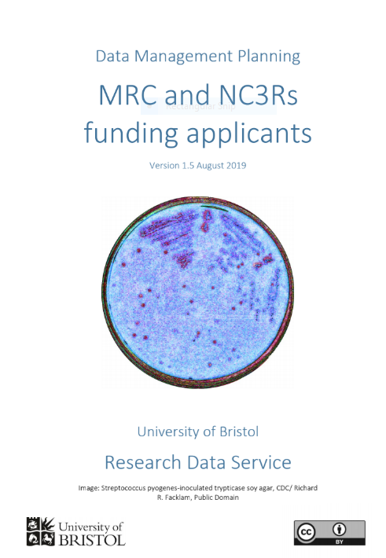
MRC: Standard applications
A DMP section of 500-1500 words is required. Template is provided
Applicants must say how data will be stored during the project
Applicants must ensure ‘opportunities for data re-use are maximised, within the regulatory requirements’ (data sharing)
DMP must match up with your Ethical Plan
Published articles to include a 'Data Access Statement' stating where the data can be accessed and under what conditions
Notes:
MRC provide a template for their Data Management Plans. https://mrc.ukri.org/documents/doc/data-management-plan-template/
There is a strong emphasis on how data will be stored during the project, both in short and medium term, and shared and discovered afterwards, eg:
Briefly describe how data will be stored, backed-up, managed and curated in the short to medium term. Specify any community agreed or other formal data standards used
What metadata is produced about the data generated from the research? For example descriptions of data that enable research data to be used by others outside of your own team. This may include documenting the methods used to generate the data, analytical and procedural information, capturing instrument metadata alongside data, documenting provenance of data and their coding, detailed descriptions for variables, records, etc.
Plans and place for long-term storage, preservation and planned retention period for the research data. Formal preservation standards, if any. Indicate which data may not be retained (if any).
Identify any data repository (-ies) that are, or will be, entrusted with storing, curating and/or sharing data from your study, where they exist for particular disciplinary domains or data types.
Is the data you propose to collect (or existing data you propose to use) in the study suitable for sharing? If yes, briefly state why it is suitable.
Indicate how potential new users (outside of your organisation) can find out about your data and identify whether it could be suitable for their research purposes, e.g. through summary information (metadata) being readily available on the study website, in the MRC gateway for population and patient research data, or in other databases or catalogues. How widely accessible is this depository?
Indicate whether your policy or approach to data sharing is (or will be) published on your study website (or by other means).
Identify who makes or will make the decision on whether to supply research data to a potential new user.
Your ethics and DMP must be a cohesive match.
We have guidance on MRC DMPs available here.

Slide 6
Wellcome Trust Fellowship
DMP submitted at application
Details of the types of data and software and their value to other researchers
Which formats and quality standards will be used to share data effectively
When, where and how you will share data and software
Any limits on data sharing
Any support required – data manager, additional storage or computational requirements
Notes:
As with MRC, Wellcome expect details about the types, formats, resources required, quality standards and plans for data sharing in their 'Outputs Management Plan' - their version of the DMP.
Wellcome's Outputs Management Plan is a mandatory element of your application. It sets out your approach for maximising the value of the following types of outputs:
datasets generated by your research
original software created in the course of your research
new materials you create – like antibodies, cell lines and reagents
intellectual property (IP) such as patents, copyright, design rights and confidential know-how.
Outputs may be shared with end-users (openly or otherwise) or be made available commercially by licensing for a fee – Wellcome expect code to be shared, but expect you to consider a) whether this will be used more widely under an Open Software Initiative licence or b) as a commercial product where a commercial partner to develops, markets, distributes or supports the ongoing use of the software. If it is the latter, you should also consider whether the output would have greater value to the research community if it was incorporated into an existing commercial product or an existing open resource, rather than making it available as a standalone product
We have guidance for Wellcome DMPs

Slide 7
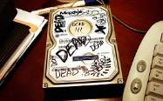
Storing data
Never store valuable/sensitive data on USB drives, Dropbox, MyFiles or any single PC’s hard drive
UoB provide the Research Data Storage Facility (RDSF*). 5TB free per PI, can be shared with collaborators
Other secure storage is fine (e.g. NHS servers, suitable departmental store)
* http://www.bristol.ac.uk/acrc/research-data-storage-facility/
Notes:
When writing your DMP, one of the first things to consider is where you will store your data.
Above all, remember to never store your data, especially if it is valuable or sensitive, on USB drives, Dropbox, MyFiles or any single PC's hard drive.
The University has a specific, safe and secure Research Data Storage Facility, which is backed up nightly to tape, with data stored in 2 secure locations. University PIs are entitled to up to 5TB of storage space, split across their projects. More space is available on disk or tape, at a cost (this will need to be factored into your costings). This storage space also gives you access to the University's Research Data Repository, for publishing (more on that later).
You can give external collaborators access to data at a file level on the RDSF, and you can access it remotely, using the VPN.
Departmental level storage is fine eg. BRMS, NHS servers, but OneDrive is only suitable for very short term/transient research data, and is not suitable for medium to long term storage.
We've got more resources on Storing and working with data on our webpage.

Slide 8
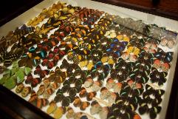
Organising data
Include how files & folders will be named
How versions will be controlled
If producing traditional databases, what the columns and row labels are
See FAIRsharing.org for standards, databases, policies used in your fields
The Research Data Service runs Data Management Training courses, and has a bootcamp and guidance documents on the webpage
Notes:
Decide up front how files and folders will be named, what versioning system you will use for them, how you will file them – your information architecture, and who is responsible for doing this - its day to day management.
Will you store by site? Month? Date? Researcher? This is crucial if you are working collaboratively with others, as then there will be no confusion over what files should be stored where, and who is responsible for overseeing data management. Will there be a lead? Will you share the load equally? Who uploads the final version of a document?
We have an One Minute Guide to file organisation on our webpage on storing data.
If you are creating a database, decide on what the columns and row labels will be before the fields are populated.
FAIRsharing.org provides details on standards – controlled vocabularies, databases, and any associated policies from funders, publishers and repositories.
We have lots of training available we are happy to run these at Faculty, School or Department level, and can also provide bespoke training for research groups. We have an introductory Bootcamp for Research Data Management.

Slide 9
Costing notes
UKRI (MRC) will cover any justifiable data management & sharing costs
RDSF storage is free up to 5TB, there is then a charge
Data publication is free with UoB Repository, other repositories may charge
Largest data-related cost is usually staff time (e.g. anonymisation, transcription)
Notes:
When costing your project, these are the things to bear in mind.
UKRI (and MRC) will cover reasonable costs, including additional storage, paying for repository costs, factoring in time for specialists to anonymise and transcribe your data, and for a data manager if the project requires I.e. if it will generate large volumes of data or complex datasets.
If you publish using the University's Research Data Repository, there is no charge to share your data, but some repositories will charge for publication, based on the size of the deposit.
Please do factor in costs for transcription and anonymisation, as you may find you do not have the time to do this, and if participants consented to sharing anonymous/deidentified data, you will be unable to share it at the end of your project. The University has confidentiality contracts with a few professional transcriptions service, if you need additional costing advice. http://www.bris.ac.uk/infosec/uobdata/transcription/

Slide 10
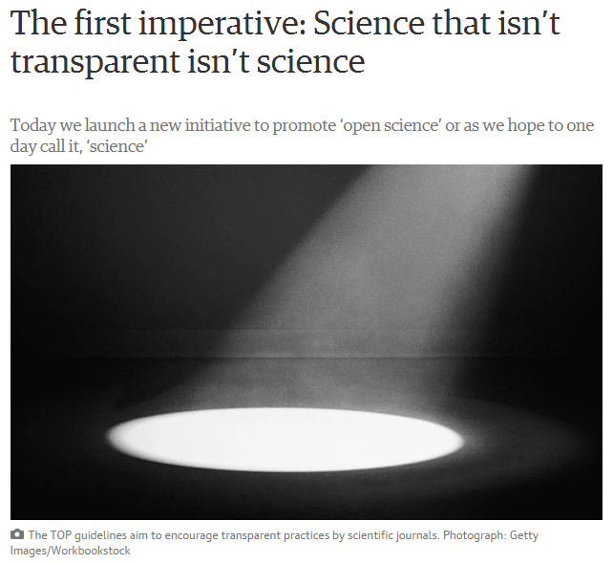
Research data & publishing
Many publishers require research data to be made available & a data access statement included in the article, e.g. Nature, Royal Society, Elsevier & Public Library of Science.
Notes:
The other point in the research lifecycle where you may find there is a requirement to share data is when you come to publish an article. Many publishers now require a dataset DOI for articles at the proofs stage, so it can be added in a template, or in a data access statement. A data access statement details where research data can be accessed and under what conditions, and many funders also require this in published articles, so it is important to remember to practise good research data management throughout your project and to expect your data to be shared at the time research outputs are published.

Slide 11
Open Access Costs
Funders usually require work to be made Open Access
Gold (Paid) Open Access
Approx £2200 per article
UKRI and Wellcome Trust provide block grants to the university for Journal Articles
Otherwise, check with funder to see if these costs should be included in application
Green (Self Archiving) Open Access
Free
Upload the Accepted Manuscript to Pure
Some journals do not have a Green Option - use Gold OA or avoid
Any questions, email lib-research-support@bristol.ac.uk
Notes:
Most funders will have a policy requiring Open Access.
There are two types of Open Access, some journals will offer both, but increasingly it will be one or the other. Both are acceptable to funders.
Gold OA costs money (about £2000), but means the final manuscript will be open access on the publishers webpages.
- Good for high profile papers.
- UKRI funders and Wellcome Trust have provided block grants to the university to pay for these. Authors with these funders should not put journal OA costs in their applications.
- Other funders will have their own rules. Authors should check with them.
Green OA is free, and can be achieved by uploading the Author's Accepted Manuscript to an institutional repository (At Bristol it's done via Pure).
- Some journals only allow Gold OA so check your major journals beforehand.
The Library Research Support team are happy to help. Email lib-research-support@bristol.ac.uk.

Slide 12
Sharing data
Sharing is often a challenge for medical disciplines
Consent, consent, consent (to SHARE)
If data will be unavailable after study for ethical reasons, say so in DMP
Otherwise plan to share via a data repository with a permanent identifier such as a DOI, e.g.
Protein Data Bank Europe - European Bioinformatics Institute (Protein sequencing)
https://www.re3data.org provides a list of repositories, searchable by discipline keyword
Figshare, Dryad or Zenodo
Bristol's own Research Data Repository, data.bris…
Notes:
Sharing data can be problemaitic in medical disciplines, because of inherent sensitivities working with health data, however, these are not insurmountable.
Firstly, please make sure that there is a line in your consent and participant information sheets which clearly states consent to share is being given - 'I consent for my data/anonymised data/data stripped of identifiers to be shared openly/with other researchers subject to a data access agreement. If you don't have this in your consent forms, you may find there are issues when you come to share your data, and it will delay or prevent publication. We have some suggested wording at the end of this document https://drive.google.com/drive/folders/1rVHu-PgYblpCpqWiksorTFnSENBeQIZX , but please do email us to check.
If you truly can't share the data for ethical reasons, please do state this explicitly in your DMP. Many poublishers now expect researchers to share underlying data at the point of publishing a paper, so you need to be able to justify the reason why you are unable to do so, and this is a good way to document it.
When you go to share, share it via a data repository, who will provide you with a permanent identifier, often a DOI, which you can link to in your published works, and link from in your dataset record.
You may have a discipline specific repository for data, for example, Genomics data, Proteomics data etc, also https://www.re3data.org/ has a searchable database of repositories.
or you may share the data through the University's Research Data Repository, data.bris. Alternatively, you may also use a commercial repository, such as Figshare, Dryad or Zenodo
'On request' is not acceptable to funders – potential data users may be unable to contact researchers as they may have moved institutions, researchers may not have brought data with them, they could have lost the only copy, and they may even be selective about who they share the data with. From a funder's perspective, this is not an appropriate way to preserve the data long term, to make it visible or to share the data widely to maximise returns from public funding.

Slide 13
data.bris.ac.uk/data
Retains data for minimum 20 years
Provides a stable, citable ‘data DOI’
Offers multiple access control options (Open, bona fide researchers only, access via UoB Data Access Committee)
Notes:
The University's Research Data Repository publishes with a DOI, and maintains the data and DOI for a minimum of 20 years
There are three levels of access – open, restricted and controlled.
Restricted and controlled access require registration and validation checks on the credentials of the applicant, the project, and the applicant's institution's governance and IT security policies before the data is released under a legally binding data access agreement.
Restricted data
Restricted data has some degree of sensitivity involved. For example, research participants have not given explicit consent to share data as Open data. However, the risk of re-identification of participants is considered low. Data is made available to approved bona fide researchers only, after their host institution has signed a Data Access Agreement.
Controlled data
Controlled data has a large degree of sensitivity involved. For example, research participants have not given explicit consent to share as Open data and/or the risk of re-identification of participants is medium to high. Requests for Controlled data are referred to an appropriate Data Access Committee (DAC) for approval before data can be shared with bona fide researchers, after their host institution has signed a Data Access Agreement.
The Data Access Committee is comprised of senior academics and professional services staff in roles such as IT governance, Data Protection, Governance, Ethics and Senior Library Staff. It operates under the recommendations made in the EAGDA report on the Governance of Data Access.

Slide 14
Key points when planning data management
Use open file formats, especially for sharing and preserving data
Organise data sensibly and provide documentation
Always have at least two copies of data
Use robust networked storage for long-term preservation
Use a repository to share data and obtain a DOI
Consider potential difficulties in sharing and try to overcome these, e.g. appropriate consent, embargoes, copyright issues
Notes:
There are a few key points to remember when planning data management, and these relate to collecting, organising, storing and sharing data
- Use open file formats wherever possible - some data may be generated in one file format for working, but converted to an open and/or less data intensive format for preservation and sharing
- Think carefully about how you will organise your data before you start to collect it – think about the information architecture and folder structure, who will be be able to access and be responsible for adding to and backing up folders before you start
- Always have at least two copies of the data, stored separately. Ideally, you should back up working data whenever changes are made, to a secure filestore and the RDSF, as these offer more security and robust storage
- Share data via a designated data repository, with a DOI
- Explicitly ask your research participants for consent to share – either openly or via controlled access, and consider any copyright issues or potential embargos before data collection begins.

Slide 15
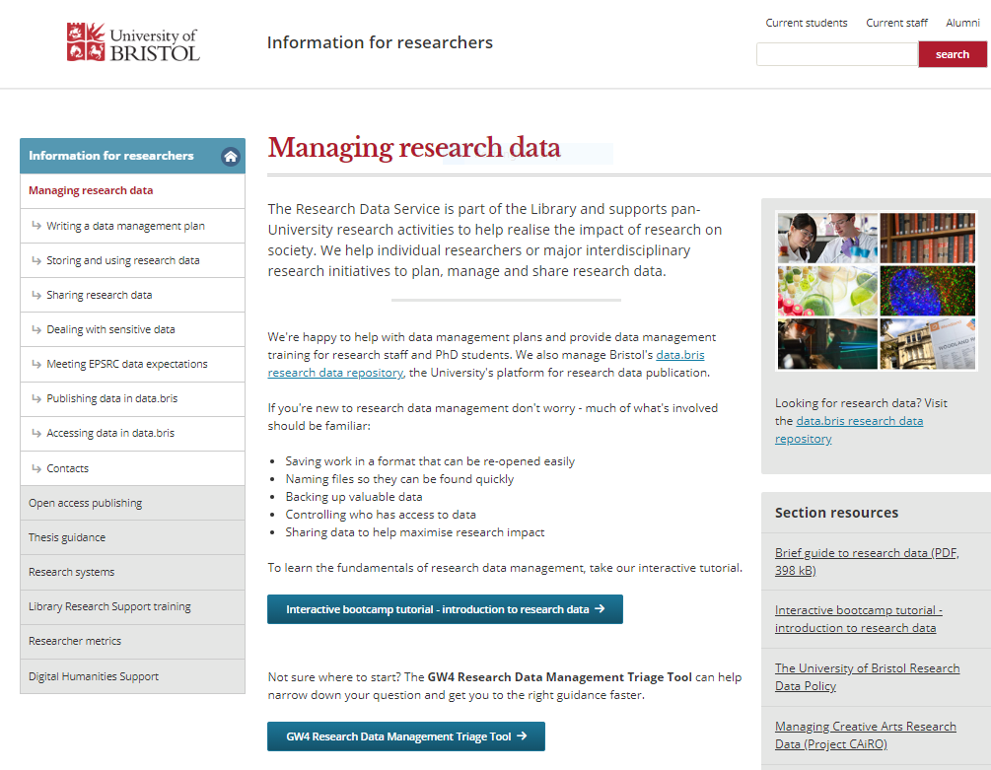
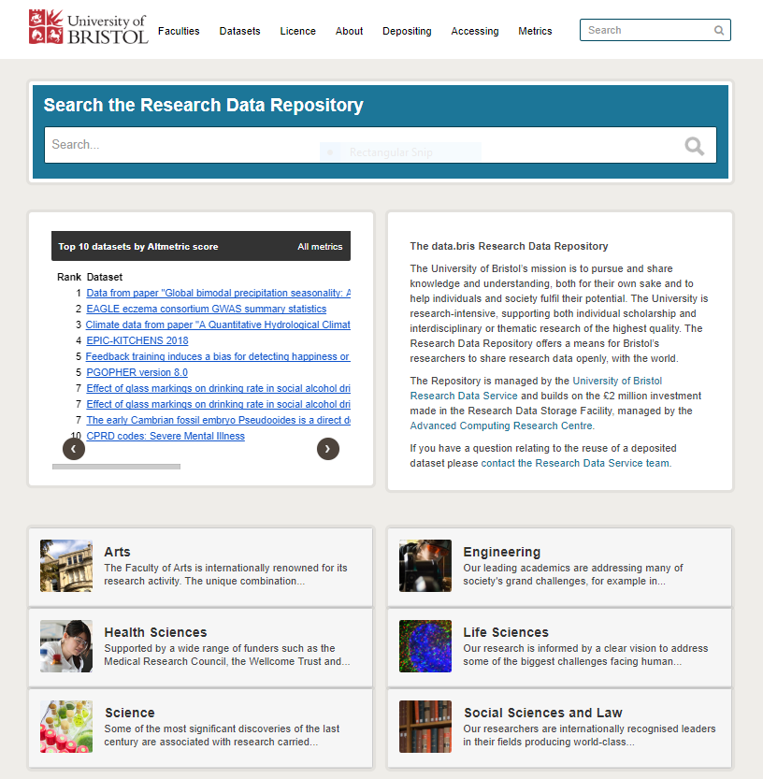
University of Bristol Research Data support
Research Data Service: helpdesk, advice, training, DMP checking (http://bristol.ac.uk/staff/researchers/data/, data-bris@bristol.ac.uk)
Research Data Repository: data publication platform; for sharing open, controlled and restricted data https://data.bris.ac.uk/data/, data-bris@bristol.ac.uk)
Research Data Storage Facility (RDSF): data storage for your project data; for PI’s, project team, and external collaborators (www.acrc.bris.ac.uk/acrc, hpc-help@bristol.ac.uk )
Notes:
If you need more help about research data management, here are our webpages.
For general help with Research Data Management, training, DMP checking and sharing data, please email us at data-bris@bristol.ac.uk
For data storage and setting up an Research Data Storage Facility account, please contact hpc-help@bristol.ac.uk

